Slide 1
Corporate Credit risk Assessment

Slide 2
PROBLEM STATEMENT
Currently banks use manual rating system rule-based system to score corporate companies based on their credit activities, finances, news, market position etc.
Scope : to develop a model for credit risk assessment of corporates using structures and unstructured data. The model somewhat mimics what a risk analyst at bank does in his head
Below is the analysis of different models used and explored currently for financial data and assessment of which performs the best :
XGBoost/Decision Trees/Random Forest: Tree based model have performed efficiently in credit scoring using financial data.
RAG based model, advance LLMs used in financial analysis. It could be only used in unstructured data of companies to extract relevant information. RAG allows models to access information beyond their training data (Could be used for personalization)

Slide 3
FEATURES USED
In this study, we utilize two categories of features:
Financial features (Key Performance Indicators: KPIs)
(a) Liquidity (Current Ratio, Quick Ratio, Cash & Bank Balances / Current Liabilities etc.)
(b) Profitability (EBITDA Margin, Net Profit Margin, ROA / ROE )
(c) Leverage & Solvency (Debt-to-Equity, Interest Coverage Ratio)
(d) Growth & Stability (Revenue Growth (YoY), EBITDA Growth, Volatility in cash flows)
Textual features extracted from banks’ credit memos

Slide 4
FEATURE DESIGN STRATEGY
• Financial features (KPIs) are prioritized, as they dominate credit risk assessment • A limited set of textual features is used to complement financial indicators • A binary feature indicates whether text is extracted from the company’s own historical memos or via peer-to-peer (P2P) comparison • Retrieval-Augmented Generation (RAG) is used to extract structured textual features from credit memos

Slide 5
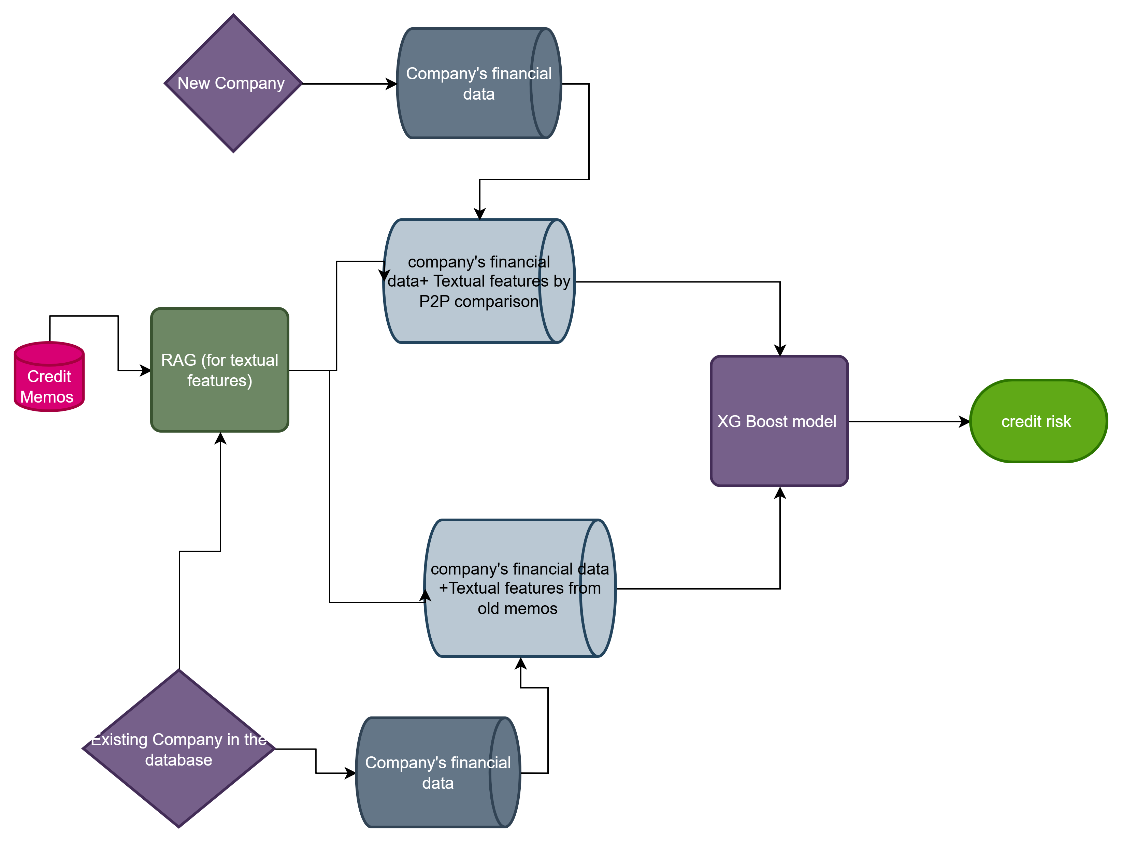

Slide 6
Textual Feature Strategy: Existing vs New Companies
• For companies with historical credit memos, textual features is directly extracted from their own memos • For new companies without prior memos, peer-to-peer (P2P) comparison is initiated to infer risk • An additional binary feature indicates whether textual features are derived from the company’s own memos or from peer companies’ memos • This distinction enables differentiation between traditional lending and P2P-based lending, supporting differential interest rate estimation and benchmarking • Peers are identified using multiple criteria, including sector, industry, and similarity in financial features

Slide 7
Data Source and Feature Construction
• We use the WinterForest US SEC 10-K filings dataset from the Hugging Face library • Financial data is extracted from the filings and organized into a structured database for this study but (in practice, this data is provided directly by the company) • Risk-related labels/features for training are generated from the same dataset (in real-world settings, these are explicitly provided in credit memos) • For companies without historical credit memos, peer-to-peer (P2P) comparison is performed based on sector, industry, and similarity in financial features to generate textual features (in practice, additional factors such as transactional data are also used)

Slide 8
CURRENT PROGRESS
Extracting Financial and Textual Features:
From the reports, we extracting the financial features through chunking it structurally and stored it in a efficient manner. The rest included chunks included things like description, heirarchy, etc. which we chunked further and summarized each sub-chunk to get a summarized theory about the company. This can be used to extract sector, industry and size of the company which can easily help us in performing P2P comparisons with other companies.

